Slide 1

Smart Document Recovery: AI-Powered Shadow Removal
for Flawless Digitization
Group member: Xinyue Zhao, Zhibo Hu
Notes:
版权声明：300套精品模板商业授权，请联系【熊猫办公设计】:http://www.熊猫pic.com，专业PPT老师为你解决所有PPT问题！

Slide 2

1
Background
2
Traditional Methods
3
Deep Learning Methods
4
DSR Dataset
5
Fine-tuning & Evaluation

Slide 3

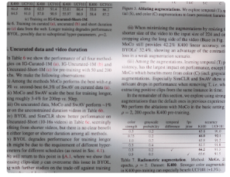
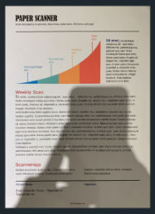
Background
Shadows are frequently occur on scanned or photographed documents. Caurse by:
Uneven lighting
Folds in the paper
Object covered during capture
...
Shadows significantly degrade the quality of the content:
Reduced human readability
Impaired machine-driven information extraction
undermine long-term archival value

Slide 4
Traditional Methods
Adaptive Thresholding: Dynamically calculates thresholds based on local pixels. Limitation:
Losing all color information
Over-removed background
Visible shadow borders
Fail to mantain information on very dark shadows
Lose contents detail on complex documents
Gamma Correction: binarized images, then enhances contrast. Limitation:
Color distortion
Over-removed background
Visible shadow borders
Lose contents detail on complex documents

Slide 5
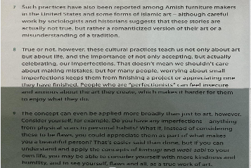
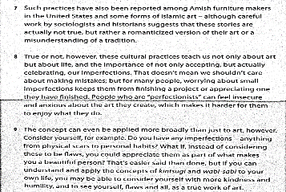
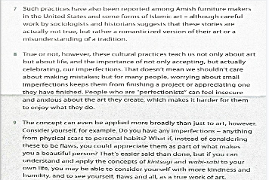
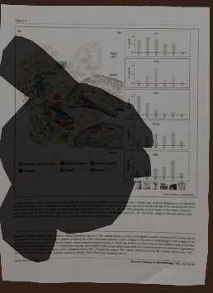
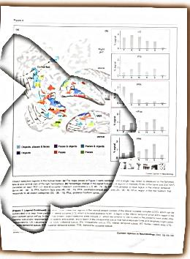
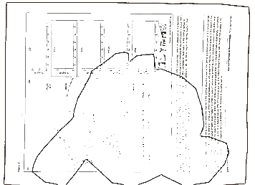
Traditional Methods
Original | Adaptive Thresholding | Gamma Correction

Slide 6
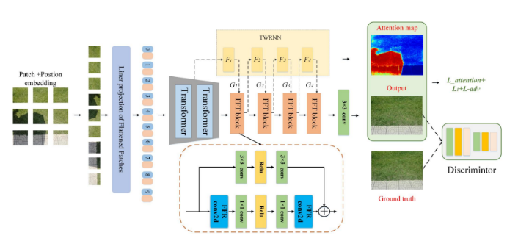
Deep Learning Methods
Compared with traditional methods, Deep Learning methods are much more widely used in practice nowadays due to their better performances.
GAN-based
Vision Transformer Encoder
Gated Feed-Forward Network
Lightweight (0.47MB)
SpA-Former - 2022 - RANKED #7

Slide 7
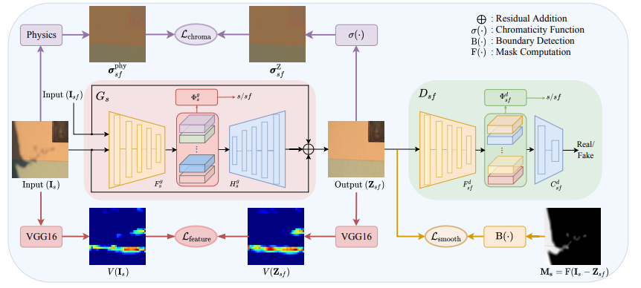
Deep Learning Methods
GAN-based
Domain classifier
Several Shadow Losses
Unsupervised
DC-ShadowNet - 2022 - RANKED #5

Slide 8
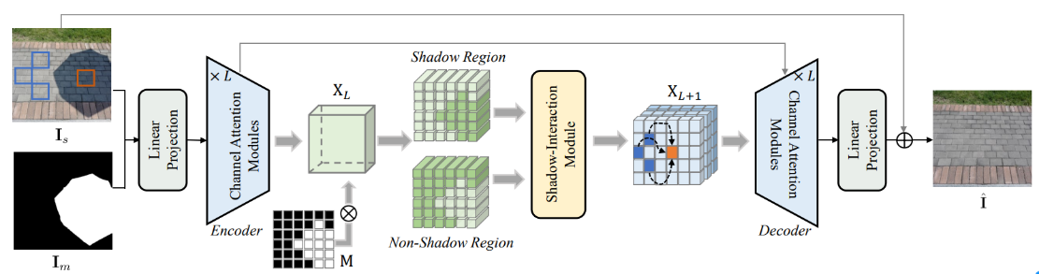
Deep Learning Methods
Shadowformer - 2023 - RANKED #1
1. Channel Attention captures global information efficiently

Slide 9
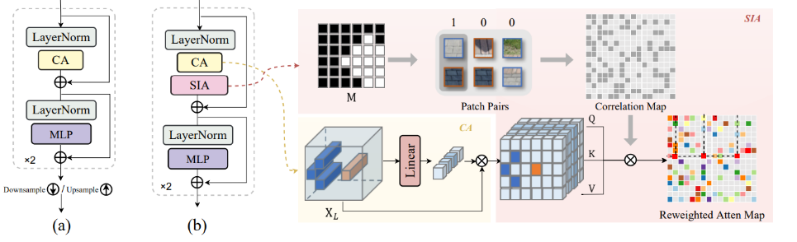
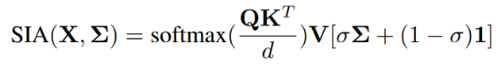
Deep Learning Methods
Shadowformer - 2023 - RANKED #1
2. Shadow-Interaction Attention
Resize shadow mask I_{m} into same size of X_{L} (one location vector of pooled feature map) we get M, the patches from shadow image can be categorized into shadow and non-shadow patches,denoted as 1 and 0. Then we can exploit the the correlation map between non-shadow and shadow region.
Reweight the attention map to emphasize the similarity between non-shadow and shadow regions.

Slide 10
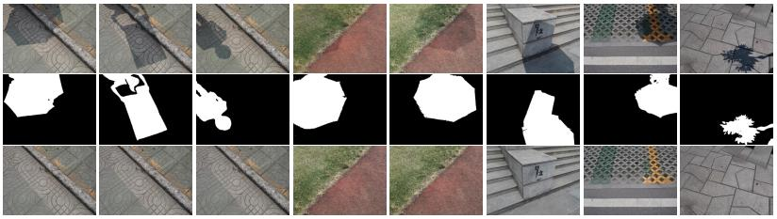
Evaluation
Based on ISTD test dataset, we completed the evaluation experiments among 3 SOTA models (SpA-former, DC-ShadowNet, Shadowformer) to evaluate their capabilities of shadow removal.
ISTD Dataset

Slide 11
Evaluation - Quantitative Evaluation Metrics
PSNR - an objective standard for evaluating images, which calculates the visual error between two images,the high the value, higher, better.
SSIM - measure the similarity between two images, higher, better.
Evaluation Metrics / Models | SpA-former | DC-ShadowNet | Shadowformer
PSNR | 29.0920 | 28.6714 | 28.2371
SSIM | 0.7148 | 0.6803 | 0.9628

Slide 12
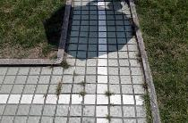
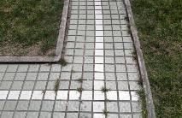
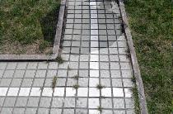
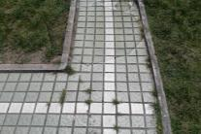
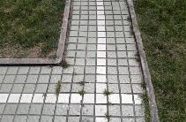

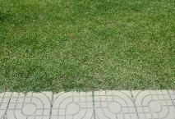
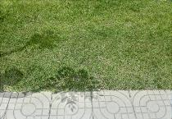

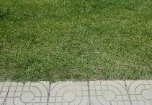
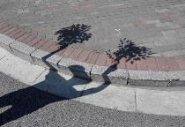
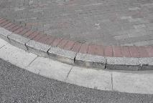
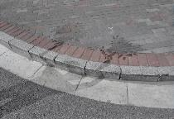
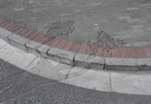
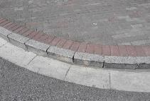
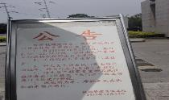

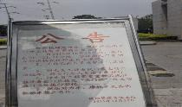
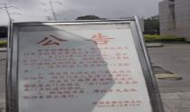

Evaluation - Visual Qualitative measure
Evaluation Result
Input | GroundTruth | SpA-former | DC-ShadowNet | Shadowformer

Slide 13
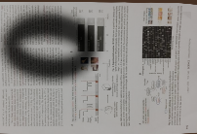
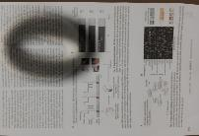
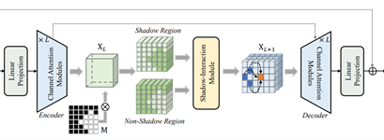
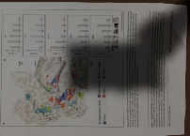
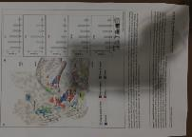

Document Recovery - Shadow Removal
We choosed the best model Shadowformer to handle document shadow removal tasks in practice, however...
Shadowformer
INPUT
OUTPUT

Slide 14
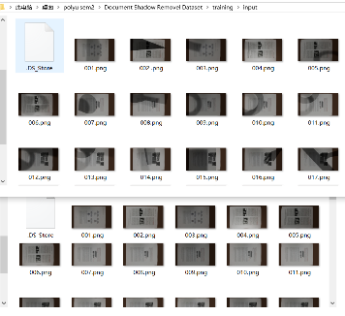
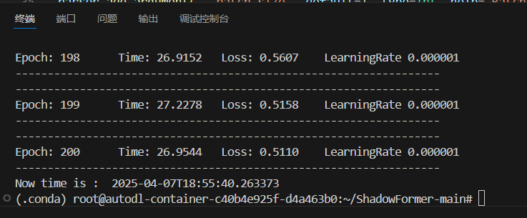
Fine-tuning & Evaluation
In order to improve model's capability to handle real-world document shadow removal, we fine-tuned the Shadowformer based on our Document Shadow Removal Dataset.

Slide 15
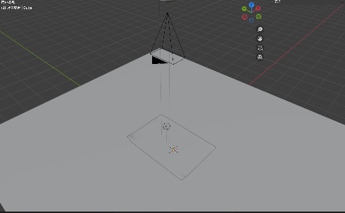

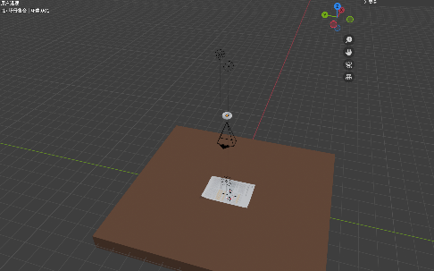
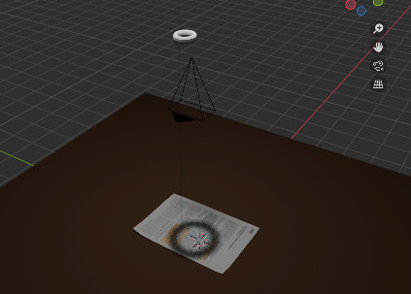
Document Shadow Removal Dataset
We used Blender to create a 3D model for quickly generate training and testing data.
We created 150 sets of images as training dataset, and 50 sets as testing dataset.
Each set of images consists of shadowed image, shadow mask and non-shadow image.

Slide 16
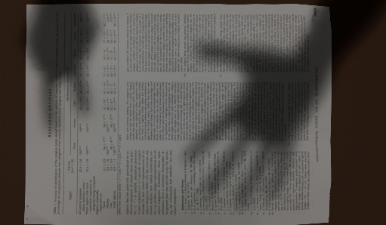
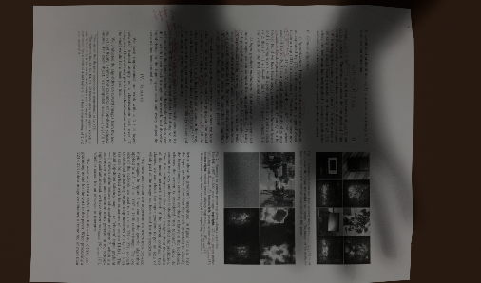
Document Shadow Removal Dataset
To enhance dataset diversity, we implemented the following strategies:
Material Variation: Applied different document photo textures to the paper models to simulate different documents

Slide 17
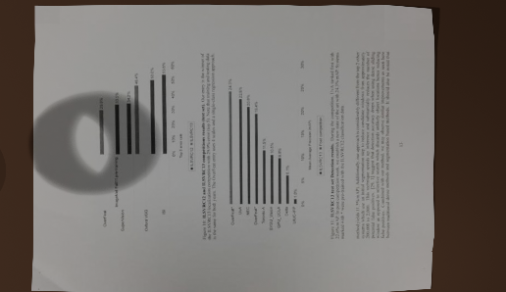
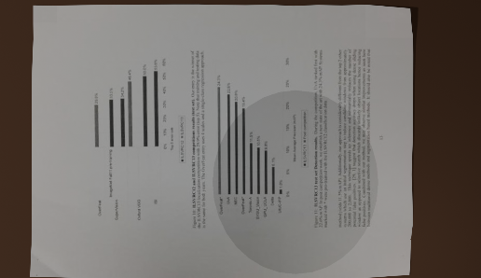
Document Shadow Removal Dataset
To enhance dataset diversity, we implemented the following strategies:
Shadow Complexity: Use different shape 3d models with various shapes to generate diverse shadow patterns.

Slide 18
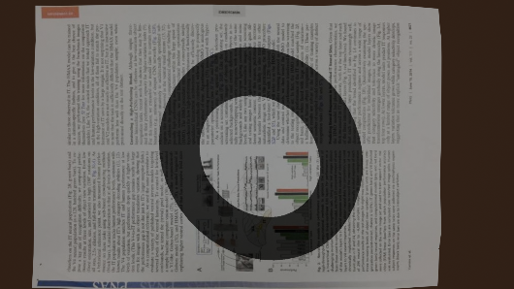
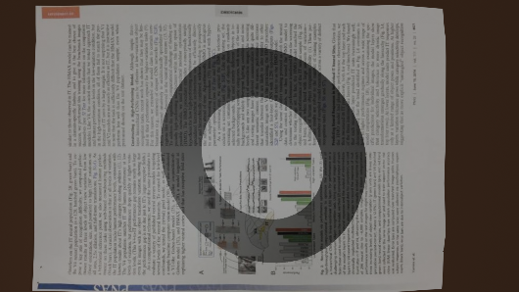
Document Shadow Removal Dataset
To enhance dataset diversity, we implemented the following strategies:
Dynamic Lighting: By adjusted the number, position, and energy intensity of light sources to create varying illumination conditions.
Single Strong Light Source
Creates sharp and well-defined shadow.
One Strong + One Very Weak Light Source
The weak light source creates subtle illumination change in shadow regions, which produce uneven shadow coloration.

Slide 19
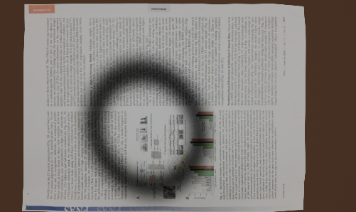
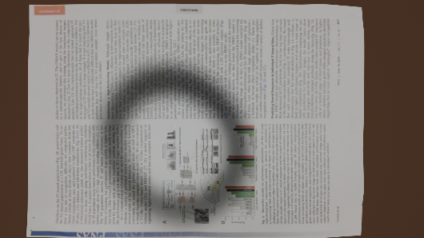
Document Shadow Removal Dataset
To enhance dataset diversity, we implemented the following strategies:
Dynamic Lighting: By adjusted the number, position, and energy intensity of light sources to create varying illumination conditions.
Single Moderately Strong Light Source
Create soft and blurred shadow edges.
One Moderately Strong + One Very Weak Light Source
Combine sample 2 and 3, generate both indistinct edge and uneven shadow coloration.

Slide 20
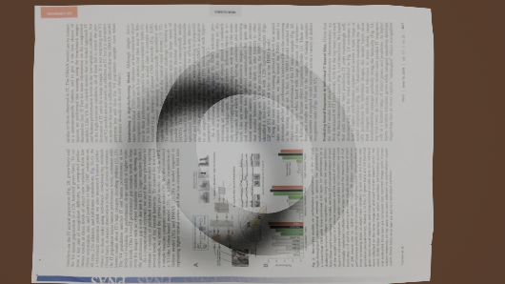
Document Shadow Removal Dataset
To enhance dataset diversity, we implemented the following strategies:
Dynamic Lighting: By adjusted the number, position, and energy intensity of light sources to create varying illumination conditions.
One Strong + One Moderately Strong Light Source
Create multiple overlapping shadows, with mix edge sharpness and uneven shadow coloration.

Slide 21
Fine-tuning & Evaluation
Similarly, we completed the evaluation experiments to evaluate the capabilities of document shadow removal of Shadowformer before and after fine-tuning.
Evaluation Metrics / Models | Before Fine-tuning | After Fine-tuning
PSNR | 19.4968 | 26.0571
SSIM | 0.7921 | 0.9364

Slide 22
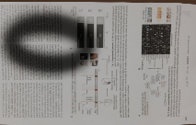















Fine-tuning & Evaluation
Input | GroundTruth | Before Fine-Tuning | After Fine-Tuning
Evaluation Result

Slide 23



Limitations
The model's capability of document shadow removal is much better after fine-tuning.
However, it's performance is not enough for practical application.
It requires better
Datasets
GPU!!!
...
Input
output

Slide 24
Q&A
Group member: Xinyue Zhao, Zhibo Hu

Slide 25
Thanks for your Listenning
Group member: Xinyue Zhao, Zhibo Hu

